Slide 1
Secrist Middle School Title I Program Home of the Scorpions
Annual Title I Parent Meeting
SY 2023-2024
Date: 8.17.2023

Slide 2
Grants
Secrist Middle School
has been allocated
$__173,988_________
in Federal Title I dollars for
School Year 2023-2024

Slide 3
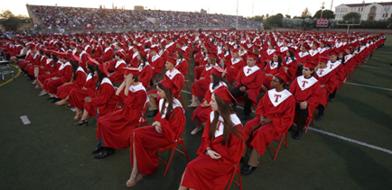
The purpose of Title I is to ensure that all students …
…receive a high-quality education
…from appropriately certified, well-trained staff
…who use evidence-based instructional methods

Slide 4
Title I Funds are for…
supporting struggling learners with additional resources and help in reading and mathematics.

Slide 5
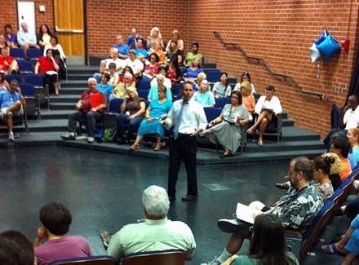
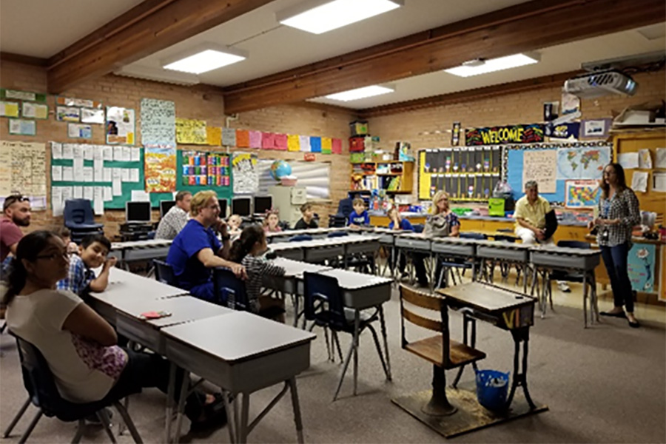
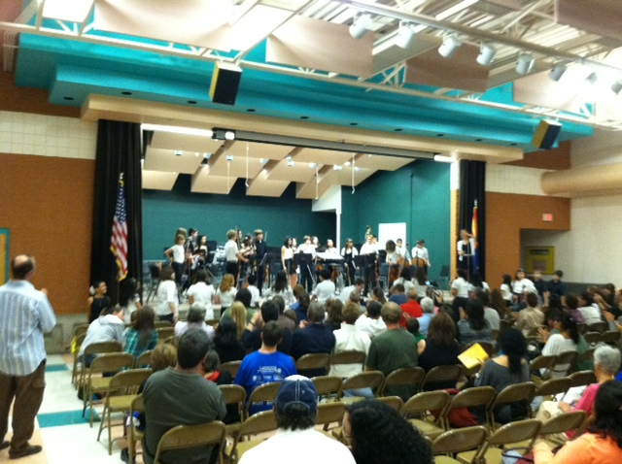
Title I funds help our school offer families
interactive learning opportunities
to
support student achievement at high academic levels

Slide 6
Arizona’s Academic Standards Assessment (AASA)
ELA-Reading | Math
AASA School City Benchmarks School City Common Formative Assessments – by Grade/Content iReady IXL AZELLA – English Language Learners | AASA School City Benchmarks School City Common Formative Assessments – by Grade/Content IXL iReady

Slide 7
School Letter Grade
The Arizona Department of Education (ADE) assigns each school a letter grade based on spring 2022 Arizona’s Academic Standards Assessment results. When the information is received, we will notify our community.
School grades are based on:
The percentage of students who passed the Arizona’s Academic Standards Assessment (AASA) exam.
The percentage of students who attained academic growth reaching or exceeding grade level expectations.
Additional factors such as the percentage of students evaluated, graduation rate-High School Only, reclassification of English language students.
Title I funds help our school maintain / improve our school score by improving student achievement through the strategic use of federal funds.

Slide 8
Integrated Action Plan (IAP)
Our school leadership team composed of staff and families completed a needs assessment in the spring. We address student needs and allocate Title I resources to support:
Well trained staff using effective teaching practices
To provide intervention for struggling students
Families to help students achieve in school
**To participate in our planning process, please contact:____________

Slide 9
Integrated Action Plan (IAP)
To ensure that all students receive a high-quality education we employ appropriately certified staff, who use research based instructional methods. Our school plan includes the following:
53 minutes of reading instruction per day. With the exception of Weds-44 mins.
53 minutes of mathematics instruction per day. With the exception of Weds-44 mins.
Curriculum Service Provider (CSP) to support teachers with teaching strategies
Response to Intervention Teachers to support Tier 2 & Tier 3 interventions
MTSS Referrals
Teacher Assistant Support (TA)

Slide 10
Integrated Action Plan (IAP)
To support struggling learners with additional resources and help in reading and mathematics, our school plan to improve reading achievement includes the following:
Reading/Math Interventions
53 minutes per day/week – IXL/iReady
Additional Reading/Math Classes for targeted students - 53 minutes of additional instruction daily
Afterschool Tutoring for Reading/Math
Reading Interventionist 6th grade
Teacher Assistants in classrooms

Slide 11
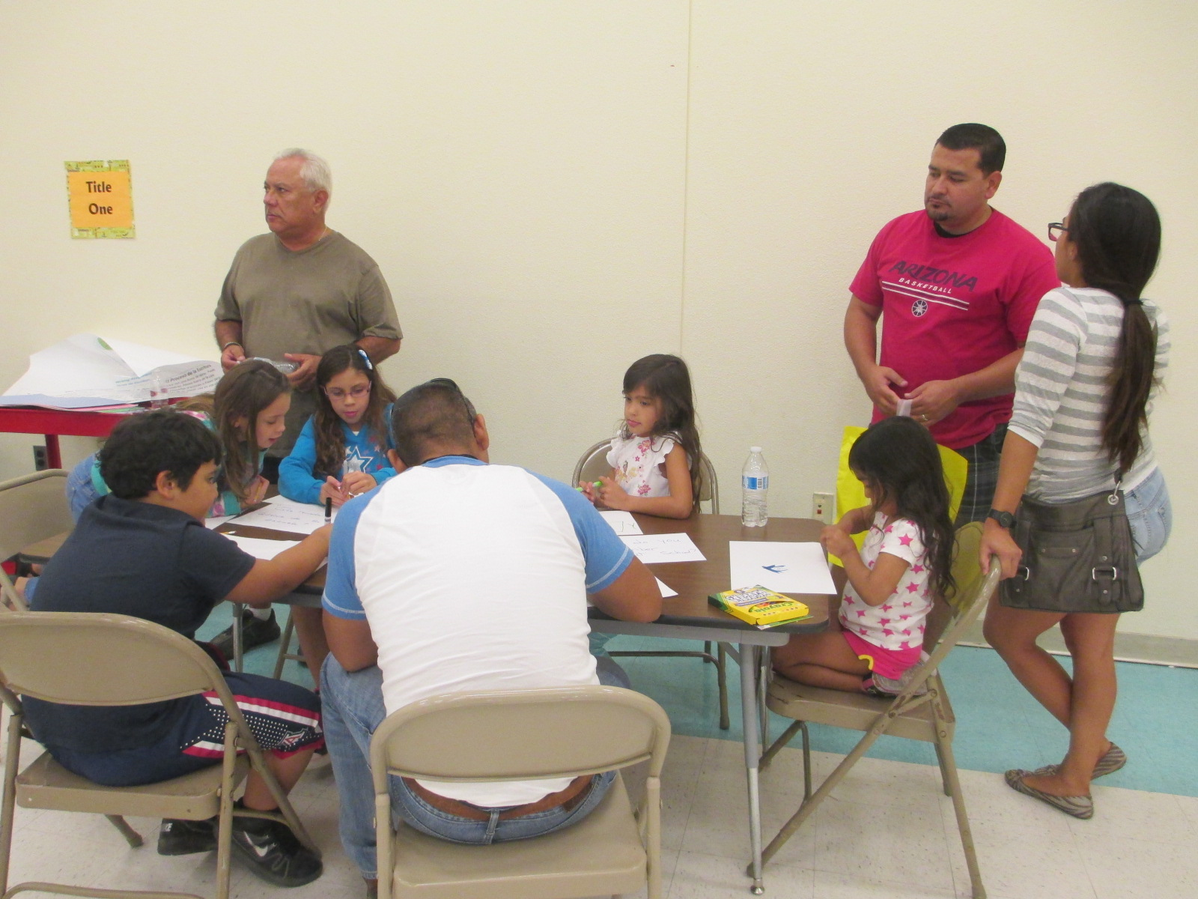
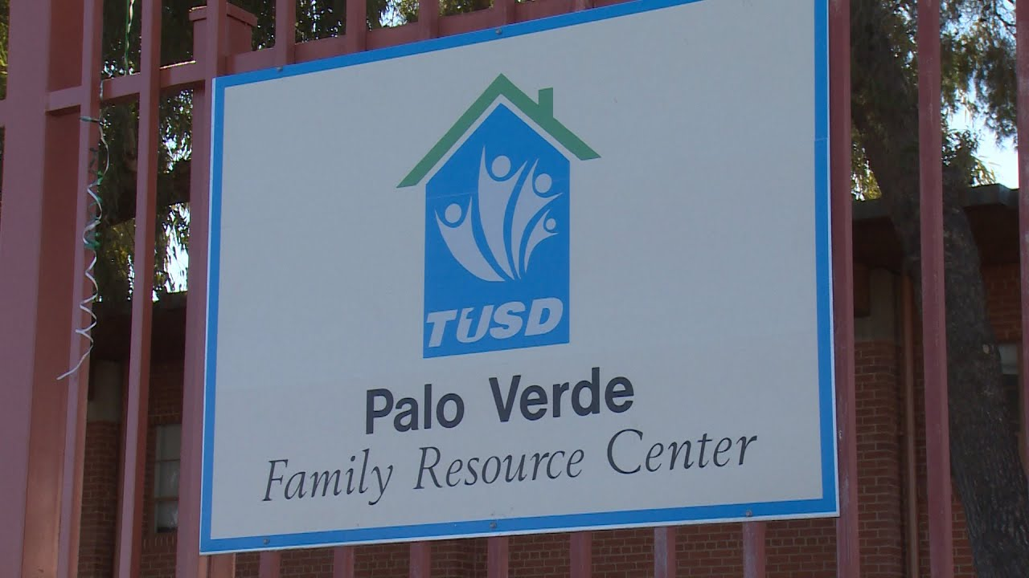
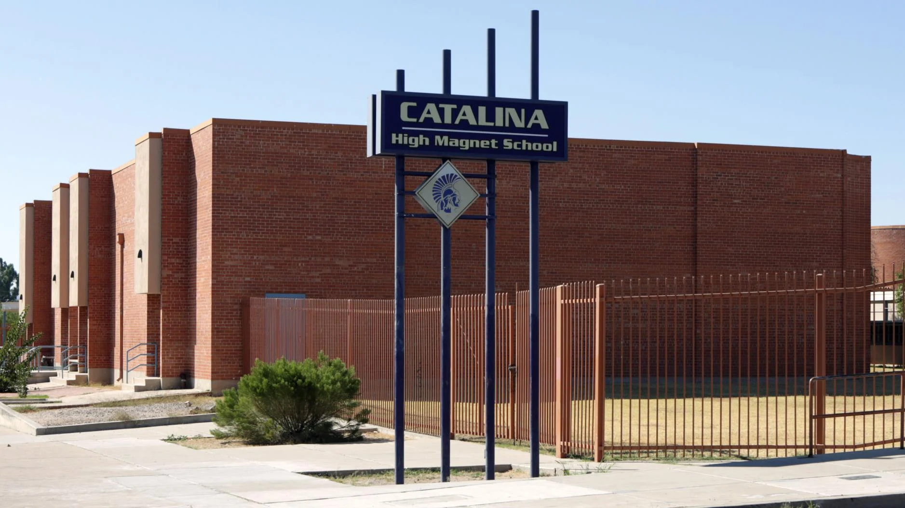
School Integrated Action Plan (IAP)
Academic Family Engagement
Our plan includes steps to promote academic family engagement:
District Parent Involvement Policy
School Parent Involvement Policy
Title I Parent Compact
Family Engagement Team (ATP)
Site Council
PTA
Academic Family Engagement Calendar, Special Events will be announced on our website, Monthly Newsletter, Notices home, Parent links &Marquee.

Slide 12
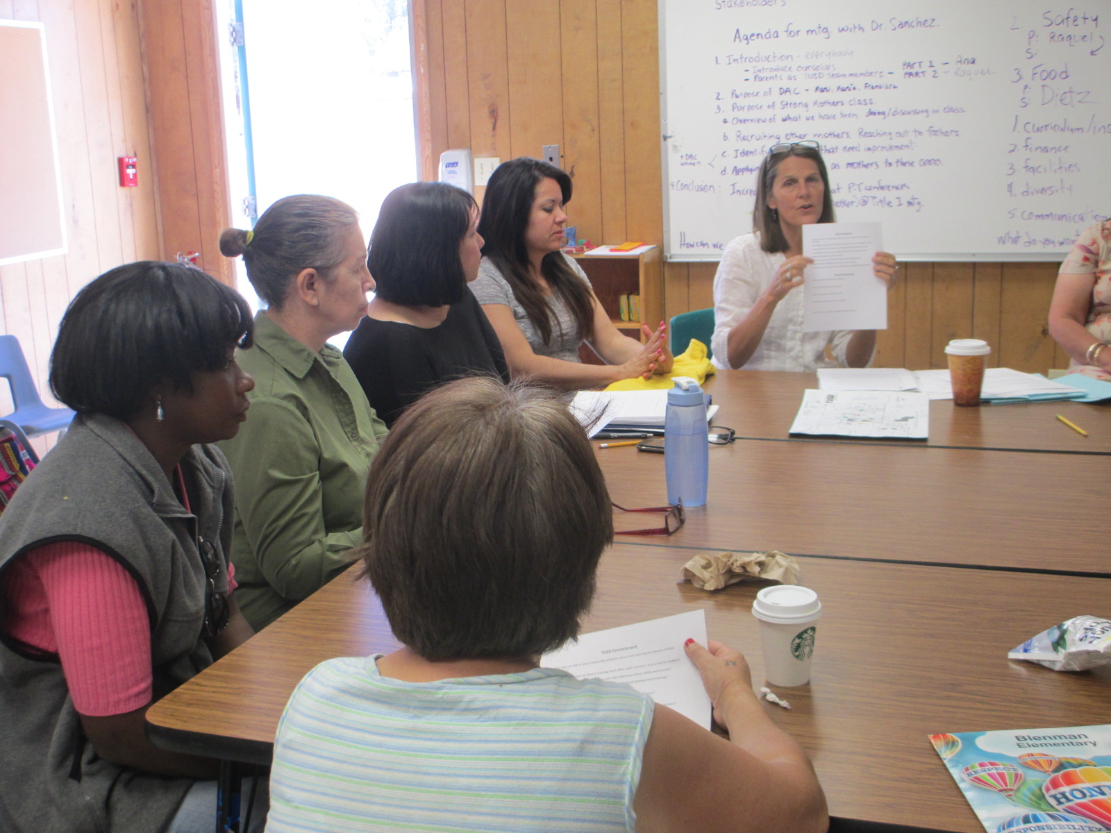
Parents Right to Know
You have the right to request:
The qualifications of your child’s teacher and instructional staff
Your child’s level of achievement based on required state assessments
You must be informed within 4 weeks if:
Your child is being taught by a teacher who does not meet the appropriately certified requirements of the state
ALL TEACHERS AT SECRIST MIDDLE ARE HIGHLY QUALIFIED
All of this information must be in a language and format that is understandable to you.

Slide 13
Important Dates to Remember
Parent Teacher Conference
September 20-22, 2023 (DISMISSAL AT 11:45 AM)
Student Progress Reports
October 17, 2023
January 9, 2024
March 19, 2024
May 23, 2024 (Last Day of School)
Updates to the school integrated action plan, the parent policy and compact
Spring 2024
Please be looking for additional upcoming events on our website

Slide 14
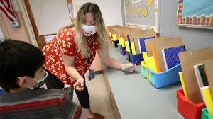
Thank you!
For more information or to access the school Integrated Action Plan Contact:
School Principal: Debbee Garcia
Email: debbee.garcia@tusd1.org
School phone: 520-731-5302

